Slide 1

PWM Generator
Project realized and presented by
Bogdan Andreea Laura
Group 2023
Eng

Slide 2
Project Requirements
Duty Cycle | [60%-80%]
Amplitude | [1V-6V]
Frequency | 600Hz

Slide 3
What is a PWM Generator
A Pulse Width Modulation (PWM) Signal is a method for generating an analog signal using a digital source.
A PWM signal consists of two main components that define its behavior: a duty cycle and a frequency.
The duty cycle describes the amount of time the signal is in a high (on) state as a percentage of the total time of it takes to complete one cycle.
The frequency determines how fast the PWM completes a cycle.

Slide 4
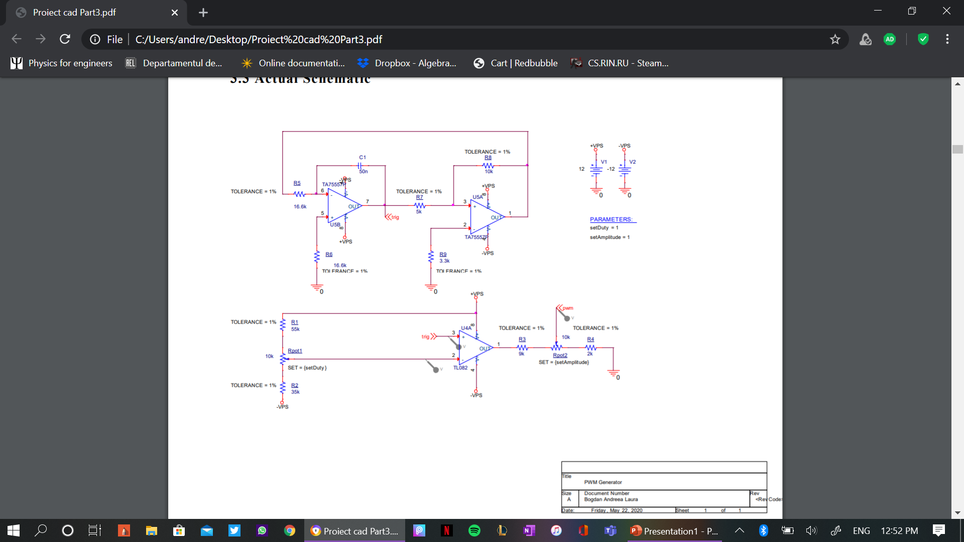
Schematic

Slide 5
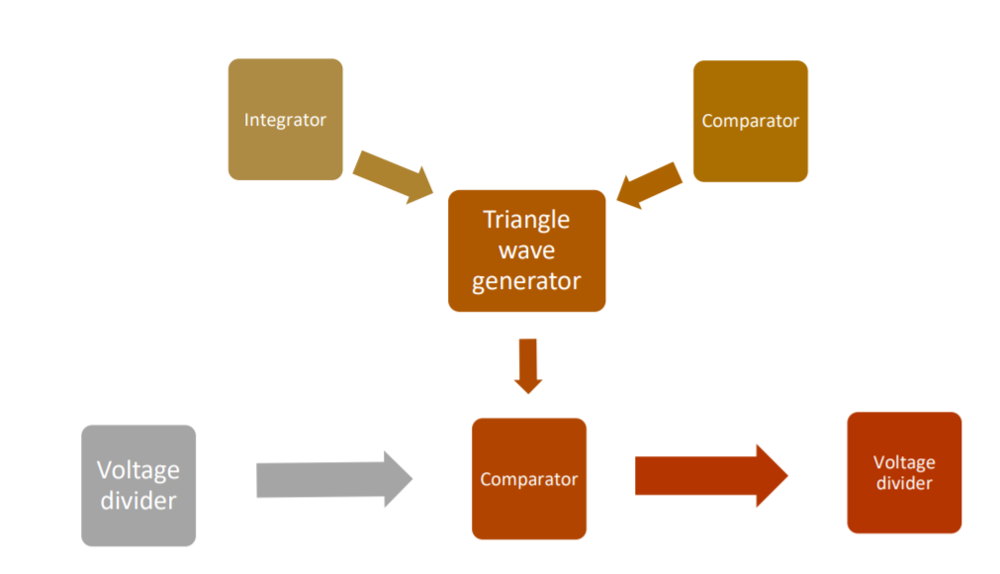
Block Diagram

Slide 6
Explained block diagram
The integrator combined with the comparator forms the triangle wave generator, which generates a triangular and rectangular signal.
The first voltage divider, containing the potentiometer Rpot1, makes the adjustment of the duty cycle between 60% - 80% possible;
The voltage comparator then receives the signal generated by the triangle wave generator and a reference voltage, the one from the first voltage divider, compares them and generates the pwm signal.
The second voltage divider, containing the potentiometer Rpot2, adjusts the amplitude of the pwm signal, which is the rectangular signal, between the interval [1V, 6V], according to the project requirements

Slide 7
Circuit Functionality
For the realization of the PWM generator, I have used the following components:
9 resistors;
1 capacitor;
2 potentiometers;
2 operational amplifiers of the type TA75557P;
1 operational amplifier of the type TL082;
2 DC voltage sources for the power supplies.

Slide 9
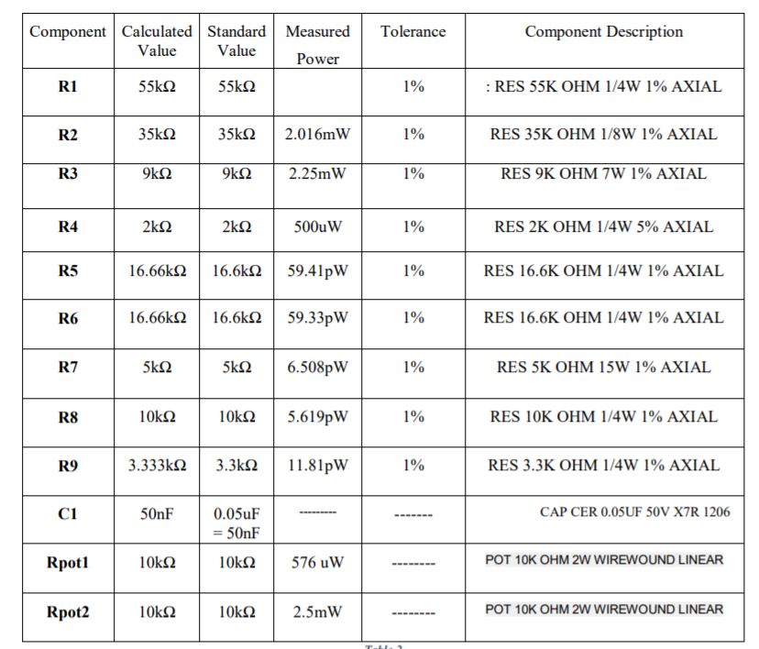
Calculated and standardized values
3.168mW
In the presented table are listed all the components: resistors, capacitors and potentiometers, with their:
Calculated values;
Standard values from real life;
Measured Power on each component;
The resistors tolerances;
Component`s description.

Slide 10
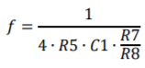
Results after using the standard values
The frequency:
The frequency calculated with the standard values of the components is 602Hz. The required frequency is 600Hz, so it can be observed that the two frequencies differ by 2Hz. The reason why this happened is because the calculated value of R5 was 16.66k and the standard value is 16.6k. Also, the standard value of resistor R5 has a ±1% Tolerance, which can cause fluctuations in it’s value ‘+’ or ‘ –’ 1%.
The Duty Cycle and the amplitude:
The duty cycle and the amplitude won`t present any differences because the calculated values of the components from the formulas which helped compute them are the same with the standard values, as can be seen in the table from the previous slide.

Slide 11
Simulations and results
The simulations I have done for the presented circuit to see it’s functionality are:
Transient;
Bias Point;
Parametric Analysis;
Monte Carlo analysis;
Worst case analysis.

Slide 12
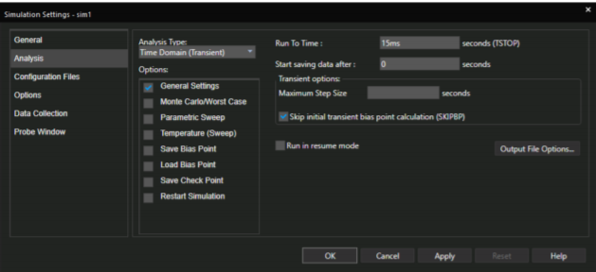
1. Transient (time domain)
This simulation lets us observe the behavior of the signal waveform in time.
Simulation profile:

Slide 13
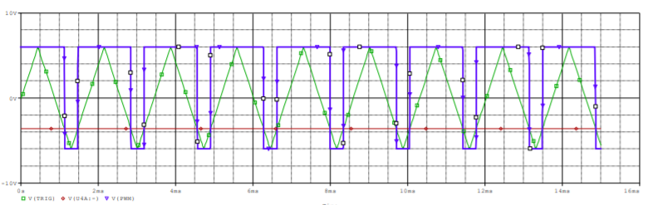
1. Transient (time domain)- Results
Simulation results
These are the results when setDuty is set to 1 and setAmplitude is also set to 1, which means that the duty cycle of the pwm signal is 80% and the amplitude is 6V.
The amplitude of the triangular signal stays at + and – 6V, with an error of about 0.05V.

Slide 14
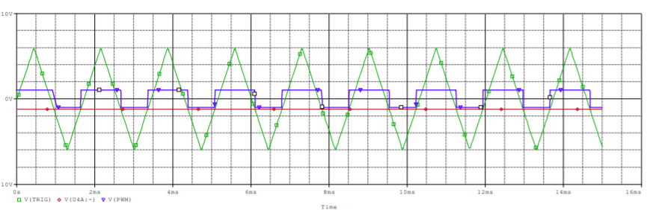
1. Transient (time domain)- Results
These are the results when setDuty is set to 0 and setAmplitude is also set to 0, which indicates that the duty cycle of the pwm signal is 60% and the amplitude is 1V.
The amplitude of the triangular signal once again stays at + and – 6V, with an error of about 0.05V.

Slide 15
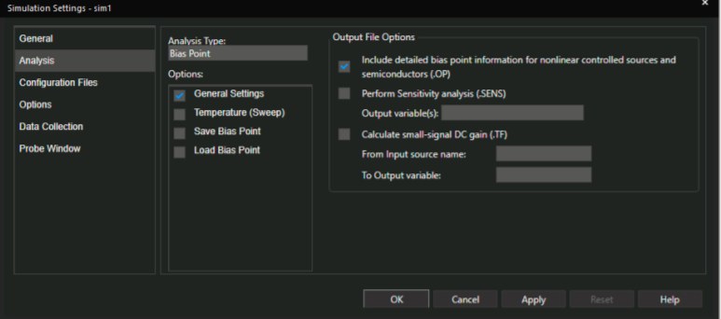
2. Bias Point
I chose to run this simulation so that I can determine the currents and power through each device. In this simulation the capacitor C1 will be treated as an open-circuit.
Simulation Profile

Slide 16
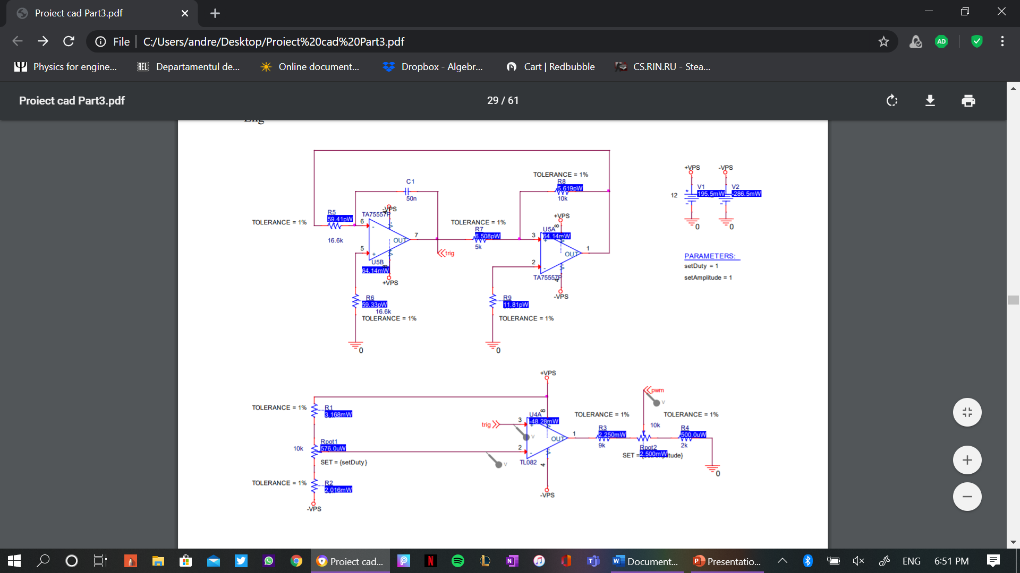
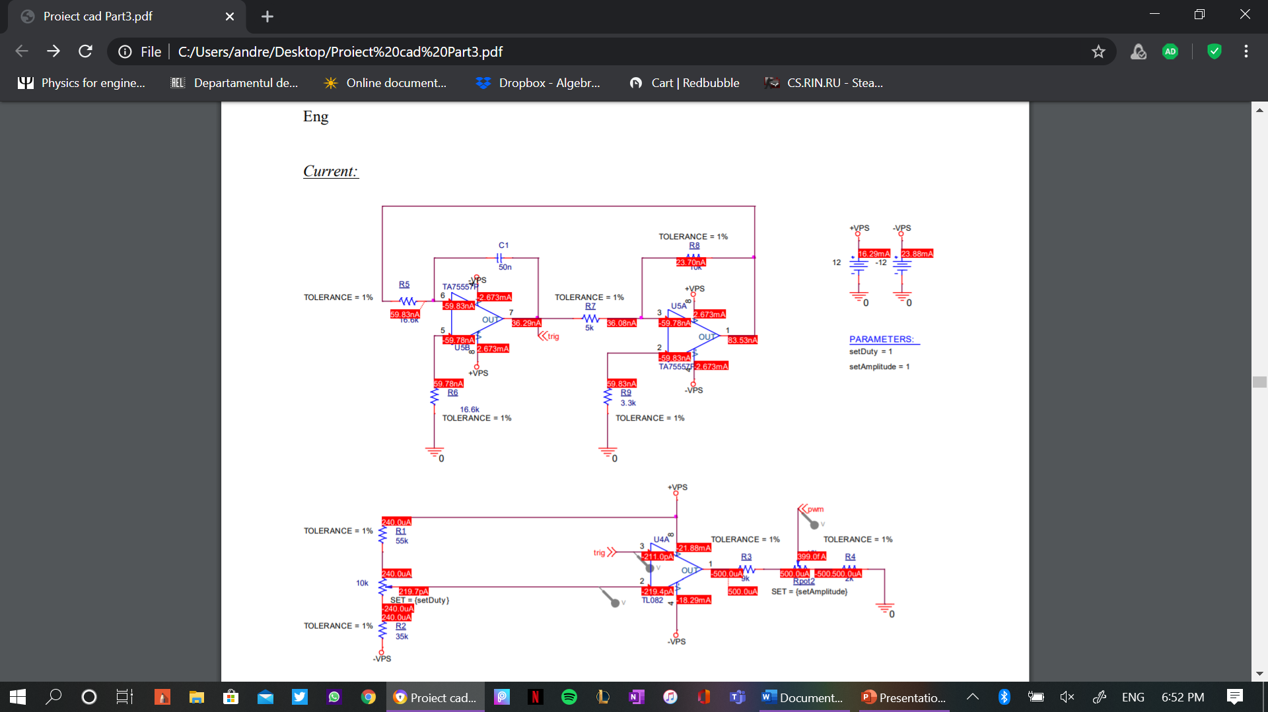
2. Bias Point-Results
Measured power on each component Measured current through each component

Slide 17
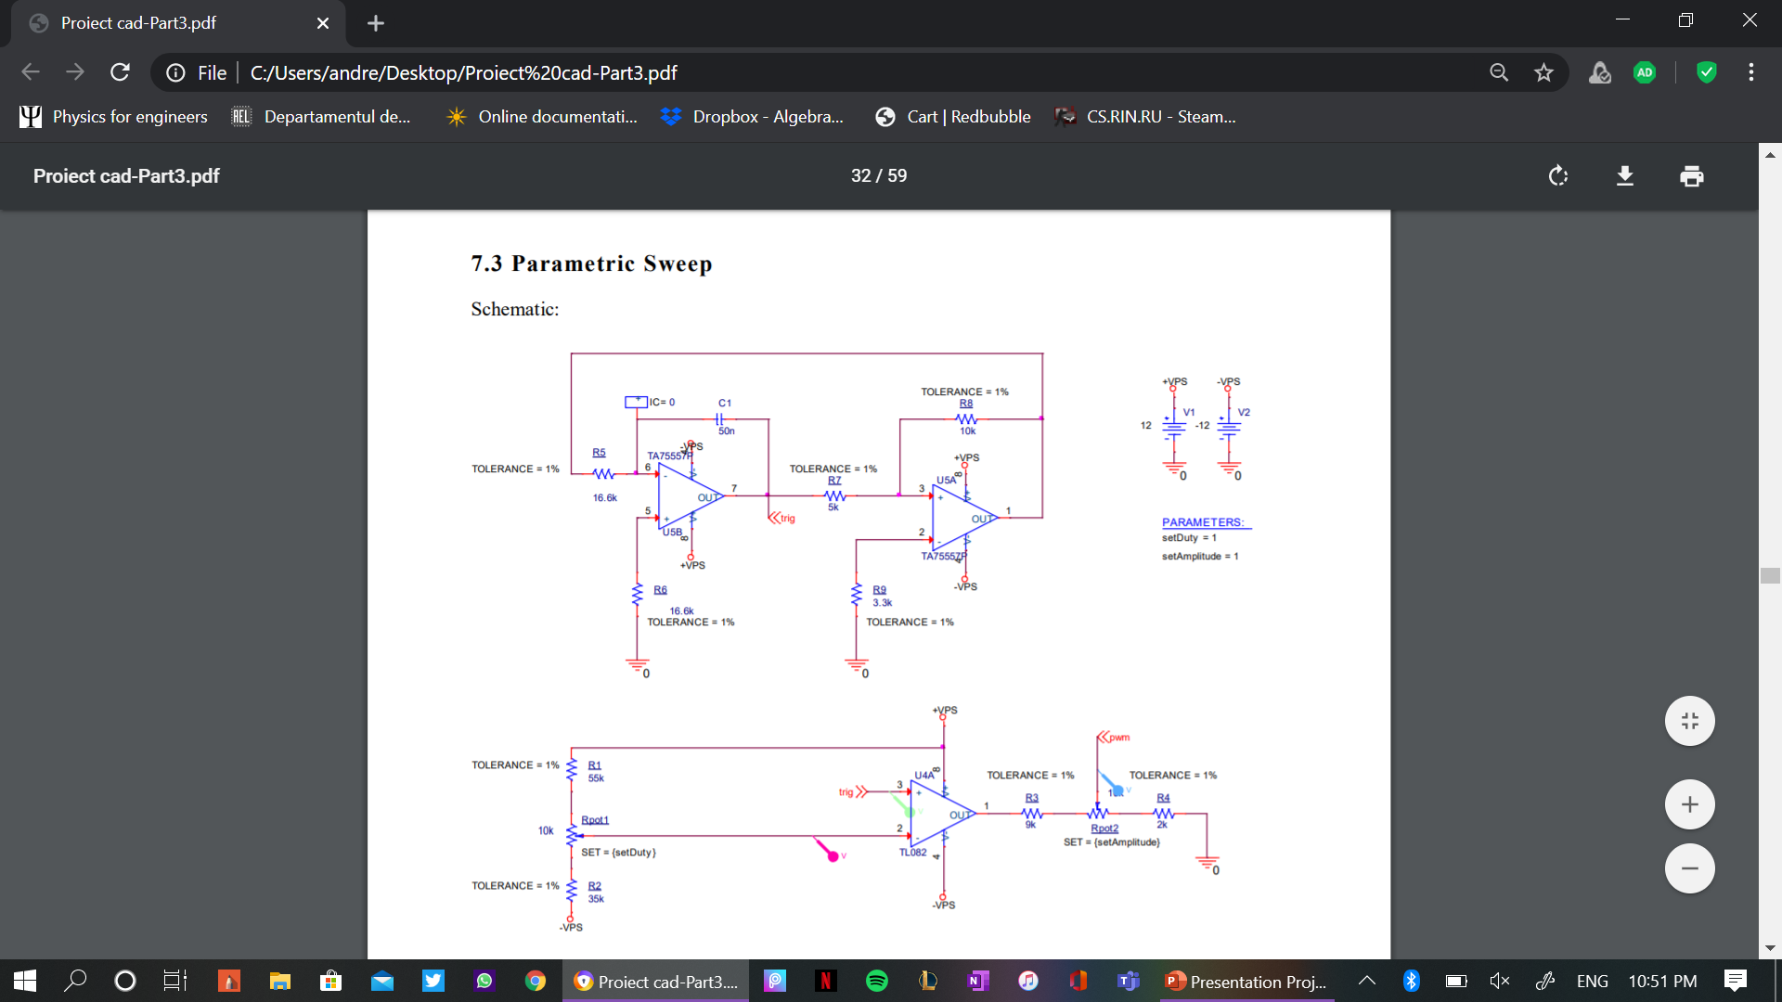
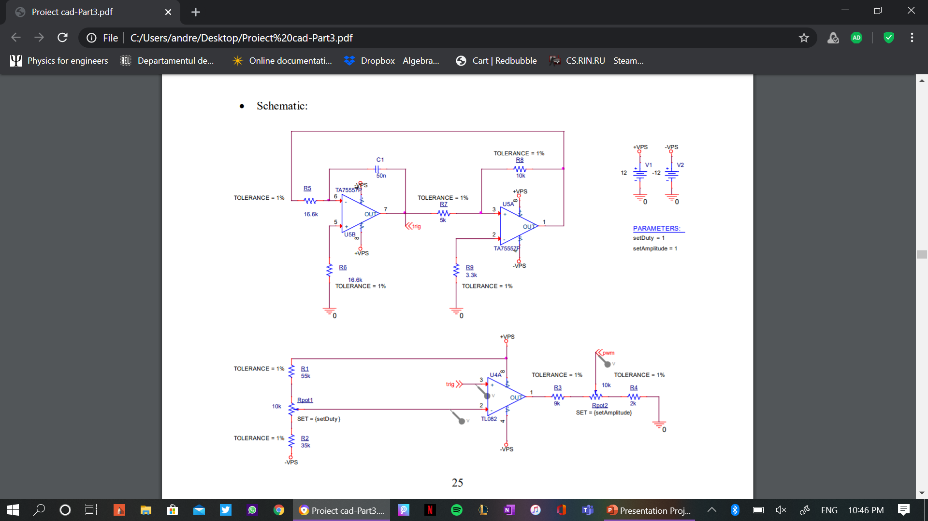
3. Parametric Sweep
I chose to do this simulation so that I can see how the components which have variable parameters, the potentiometers Rpot1 and Rpot2, influence the signal. Rpot1 (setDuty) varies the duty cycle between [60%-80%] and Rpot2 (setAmplitude) varies the amplitude of the PWM cycle between [1-6V].

Slide 18
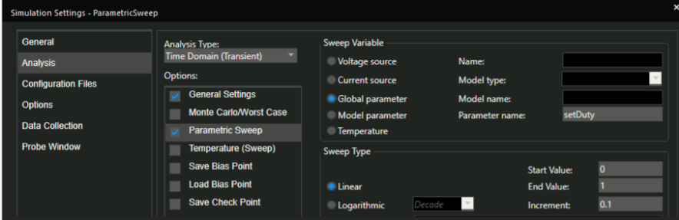
3. Parametric Sweep-Simulation Profile
Simulation profile for the adjustable duty cycle (setDuty).

Slide 19
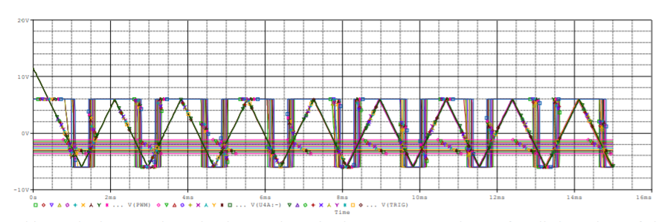
3. Parametric Sweep - Results

Slide 20
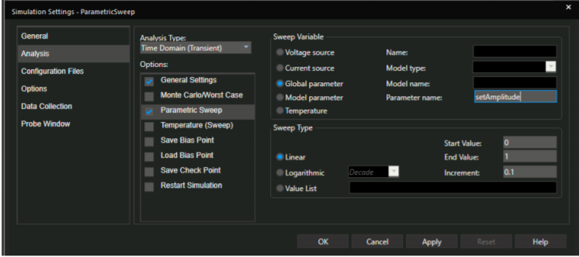
3. Parametric Sweep-Simulation Profile
Simulation profile for the adjustable amplitude (setAmplitude).

Slide 21
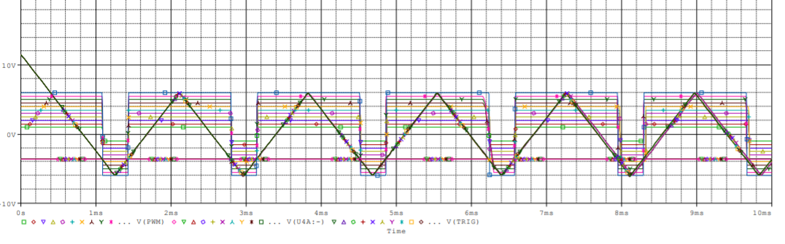
3. Parametric Sweep - Results

Slide 22
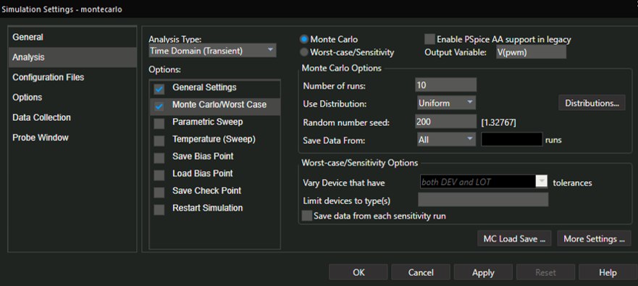
4- Monte Carlo analysis- simulation profile

Slide 23
4. Monte Carlo analysis- Results
The Monte Carlo analysis shows the resistors’ tolerances variation on the circuit.

Slide 24
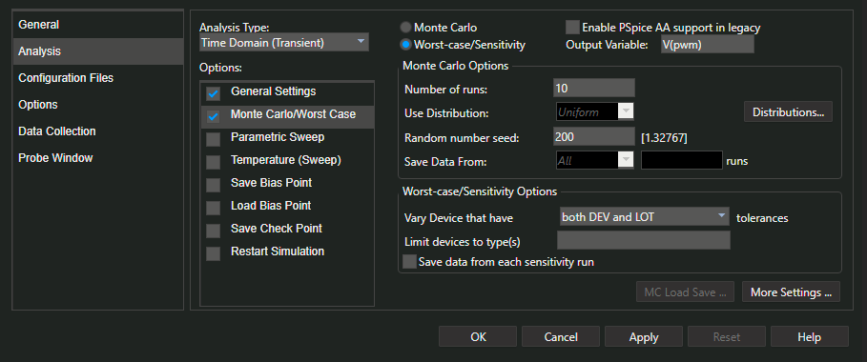
5. Worst Case Analysis- simulation profile

Slide 25
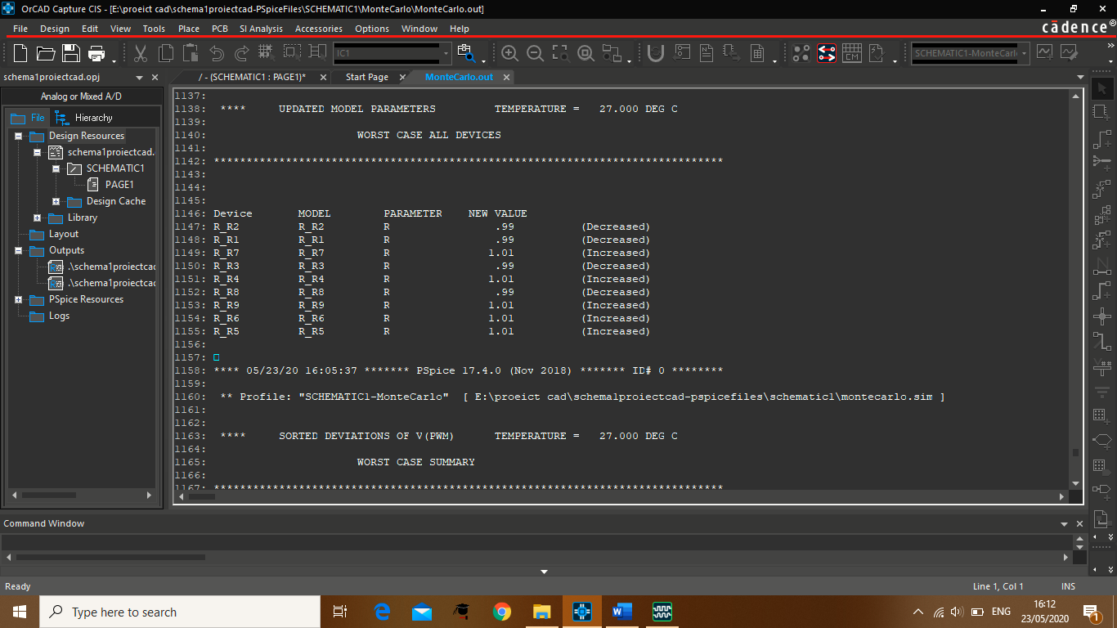
5. Worst Case Analysis- Results

Slide 26
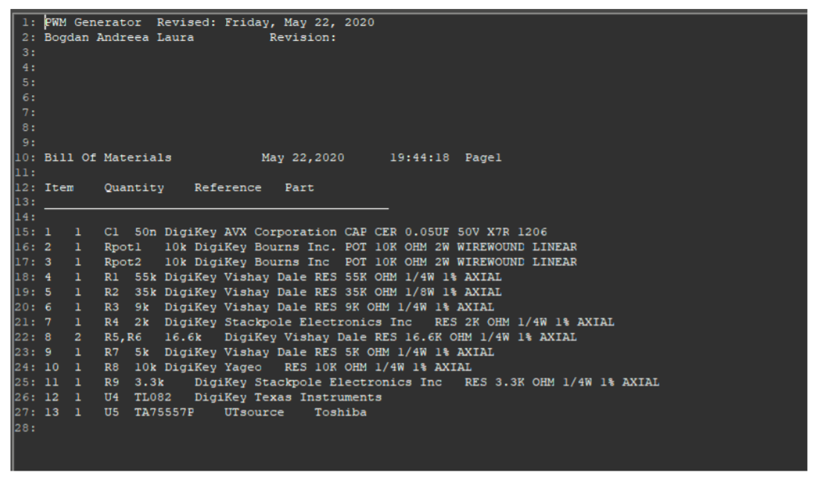
Bill of materials

